Slide 1



Census Income Prediction
(CIP)
Huijun Hong
CS 767
Final project

Slide 2
Contents
1
Summary
2
3
Dataset
4
Approaches
Results
5
Conclusion &
Lesson Learned

Slide 3
1
Summary

Slide 4
Summary
My proposed project is to predict whether a person earns more than 50,000 dollars a year based on the census information, such as age, education level and gender.
I name the task as CIP, short for census income prediction.

Slide 5
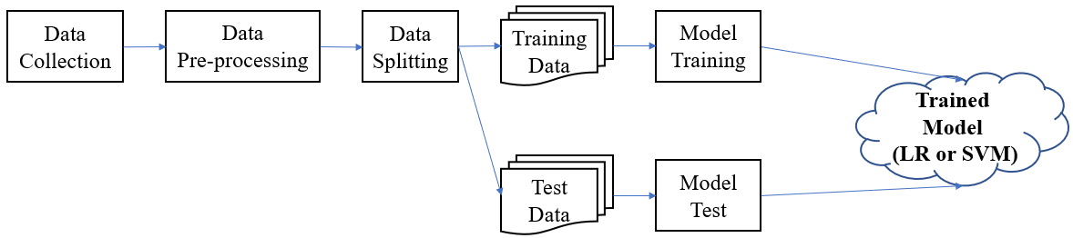
Summary
The workflow of CIP is presented above, which follows traditional machine learning designs, i.e., collect data first, and pre-process the data (including eliminating noise, filling the missing values and normalization et al.), and then split the data into training and test part.
In my project, I choose logistic regression and support vector machine for my models.

Slide 6
2
Dataset

Slide 7
Dataset
2
1
UCI Adult, it is a “Census Income” Dataset
Description
1
Name
3
Predict whether income exceeds $50K/yr based on census data. The dataset contains 32,561 samples, each consists of 14 attributes.
2
Source
4
3
UCI Machine Learning Repository: http://archive.ics.uci.edu/ml/datasets/Adult
Sample
A sample record may represent an eighteen years old, unemployed high school student
4
Dataset

Slide 8
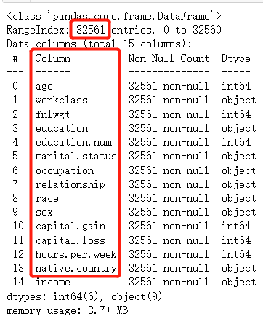
Dataset
2
1
UCI Adult, also known as “Census Income” Dataset
Description
1
Name
3
Predict whether income exceeds $50K/yr based on census data. The dataset contains 32,561 samples, each consists of 14 attributes.
2
Source
4
3
UCI Machine Learning Repository: http://archive.ics.uci.edu/ml/datasets/Adult
Sample
A sample record may represent an eighteen years old, unemployed high school student
4
Dataset

Slide 9
3
Approaches

Slide 10
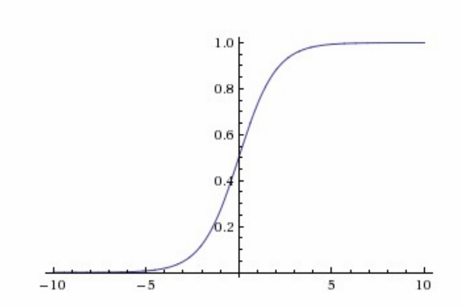
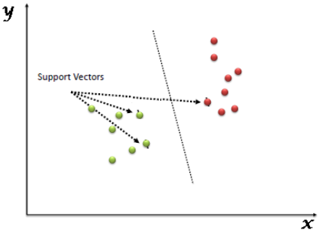
Approaches
Support Vector Machine
Logistic Regression

Slide 11
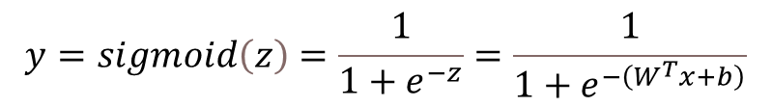
Approaches – Logistic Regression
Logistic regression (LR) is one of the most popular, widely-used, easy to understand and implement machine learning algorithms, especially when confronting with binary classification tasks. The basic formular of LR is a sigmoid function and is presented below. Where W and b are model parameters that need to be solved via training and x is the feature vector, i.e., the census data in my project.
Logistic Regression
$$y=sigmoid\left(z\right)=\frac{1}{1+e^{−z}}=\frac{1}{1+e^{−\left(W^{T}x+b\right)}}$$
Notably, LR outputs real values between 0 and 1. The larger the output value, the more likely that the associate sample belong the positive class. Normally, if LR predicts a value larger than 0.5, we will think that the associate sample is in the positive class.

Slide 12
Approaches – Support Vector Machine
Support Vector Machine
Support vector machine (SVM) is another widely-used and powerful machine learning algorithm in solving binary classification tasks. Imagine that data samples are essentially points in n-dimensional space, where n is the number of features. SVM tends to find the hyper-plane that can perfectly differentiate points that are in different classes. In other words, SVM can divide the points of the same class to the same side of the hyper-plane. SVM is more difficult to understand, but in many cases, outperforms LR in binary classification tasks with a great number of features.

Slide 13
4
Results

Slide 14
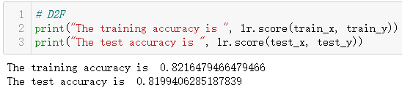
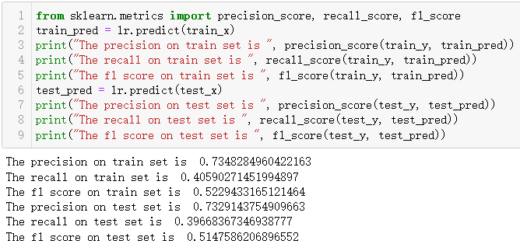
Results – Logistic Regression
Logistic Regression

Slide 15
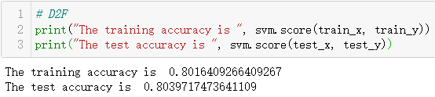
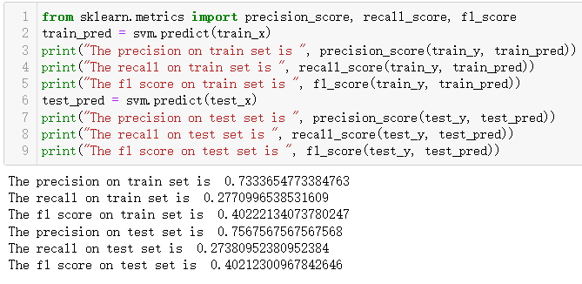
Results – Support Vector Machine
Support Vector Machine

Slide 16
5
Conclusion &
Lesson Learned

Slide 17
Conclusion & Lesson Learned
What did not work well
The classification performances of logistic regression and support vector machine are both disappointing. I expect models with high classification accuracy (larger than 90%), but I only got over 80% accuracy. In reality, it certainly not good enough. I am new to machine learning, and always think machine learning is kind of a magic and magically have impressive performances. From this project, I realize that I was wrong. Machine learning can be quite powerful, but only when the overall procedure, such as data collection, pre-processing, model and hyper-parameter selection, is all accomplished appropriately. Those work can be really time consuming.
What did work well
Through this project, the most significant aspects of my project that meet my desires are that I get familiar with the complete procedure of solving problems with machine learning techniques. I get to know that data processing or feature engineering is as important as, or even more important than model and hyper-parameter selection. I also realize that evaluation should be conducted with multiple metrics, a single or only a few metrics may give false impressions.

Slide 18



Thanks for Your Time.

